Slide 1
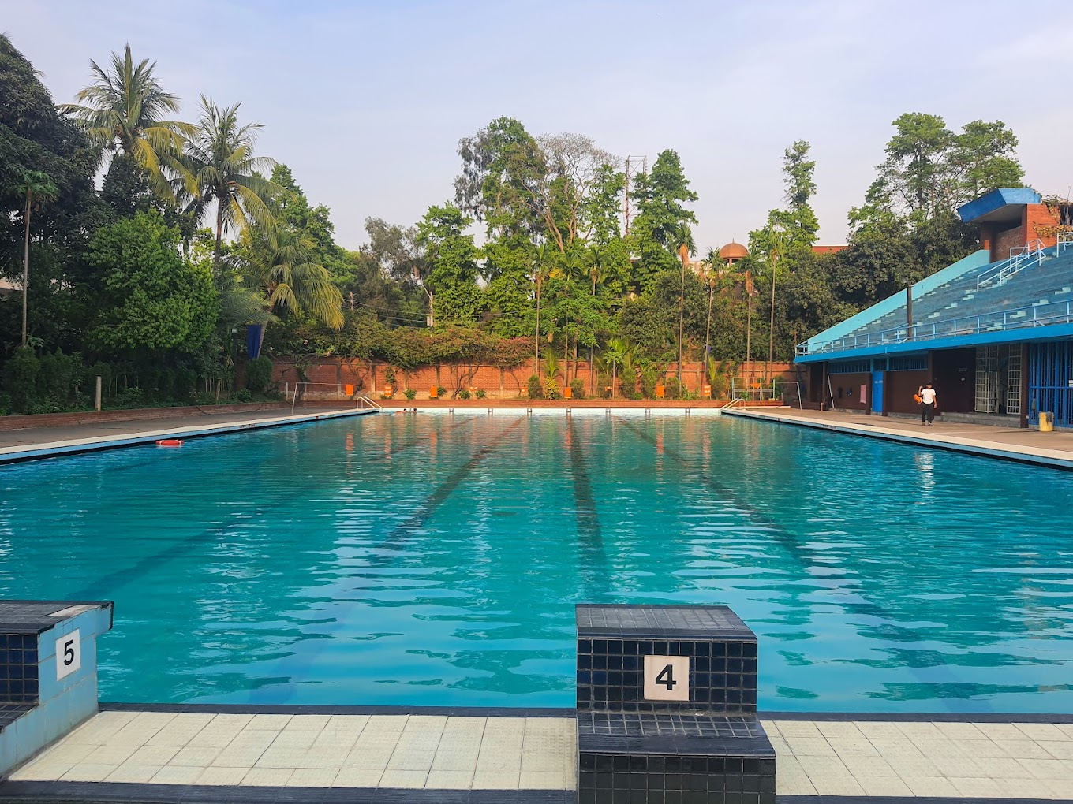
SPL-02
Dhaka University Swimming Pool Management System
Ibne Bin Rafid
Roll : 1330
Eftekhar Mahmud Efty
Roll : 1309
Supervised By,
Abdus Satter Rifat
Assistant Professor
IIT, DU

Slide 2
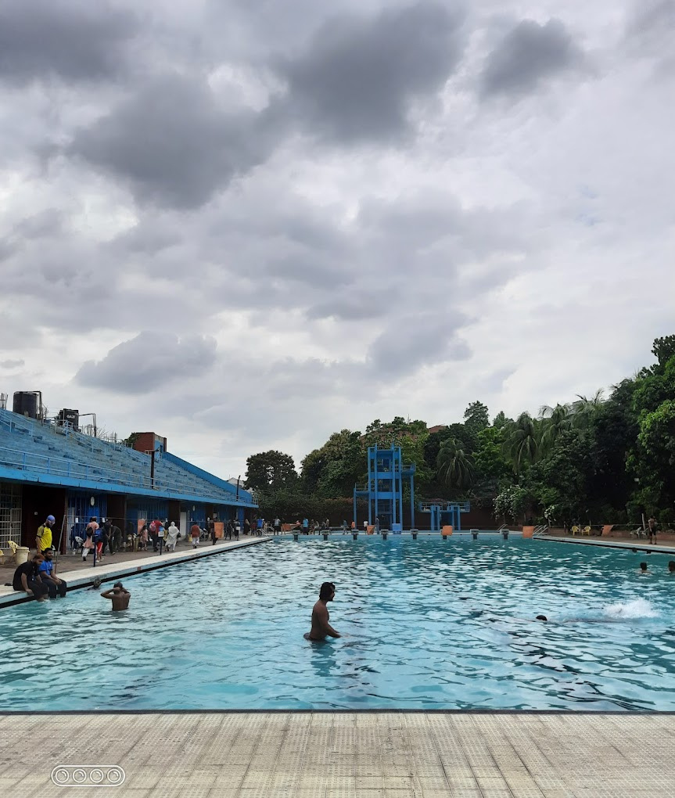





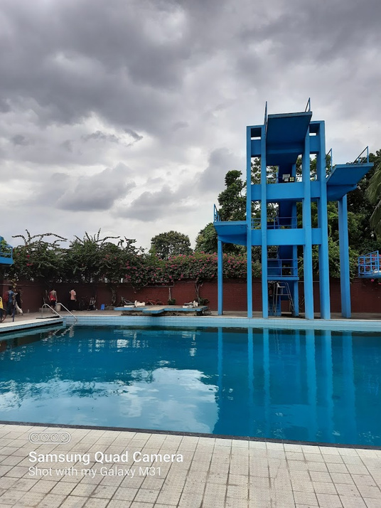


WEB PROJECT
IT WILL BE A
Tools
&
Technologies

Slide 3
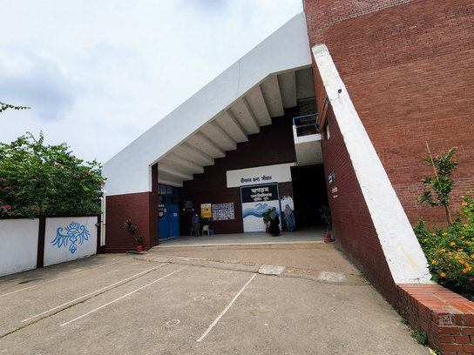
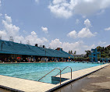

INPUT
USER REGISTRATION INFORMATION,
FINANCIAL TRANSACTIONS,
ATTENDANCE RECORDS,
EVENT DETAILS,
SUPPLIER INFORMATION ...
OUTPUT
USER NOTIFICATIONS,
ATTENDANCE REPORTS,
FINANCIAL REPORTS,
SUPPLIER ORDERS AND CONFIRMATIONS,
DATABASE UPDATES,
USER REVIEWS AND FEEDBACK ...

Slide 4

OUR
PROGRESS SO FAR
Talked to Swimming Pool officials, we will sit with them again today
Fixed some features and more to go
Working on SRS
Doing background study
Learning necessary languages & technologies
PROGRESS TRACKER

Slide 5

THANK YOU
FOR YOUR ATTENTION

